Slide 1
caCORE SDK Workbench
Dan Dumitru/
Satish Patel

Slide 2



Current Workflow
Configuration File
XMI File

Slide 3
SDK Workbench Features
User friendly way to use configure SDK
Validates user inputs before generation
Enhanced system configuration
  SDK code generation feature selection
  Vendor specific database configuration
  Vendor specific application server configuration
  Detailed security configuration
Deployment support (future)

Slide 4
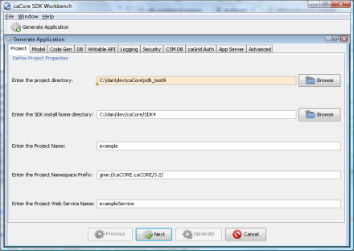
Proposed Workflow
XMI File
caCORE SDK Workbench
Configuration File

